Slide 1


DATA ESSENTIALS
SFPD Stops (2018 / 2023)
Groupe : Anaïs / Romain / Kevin

Slide 2
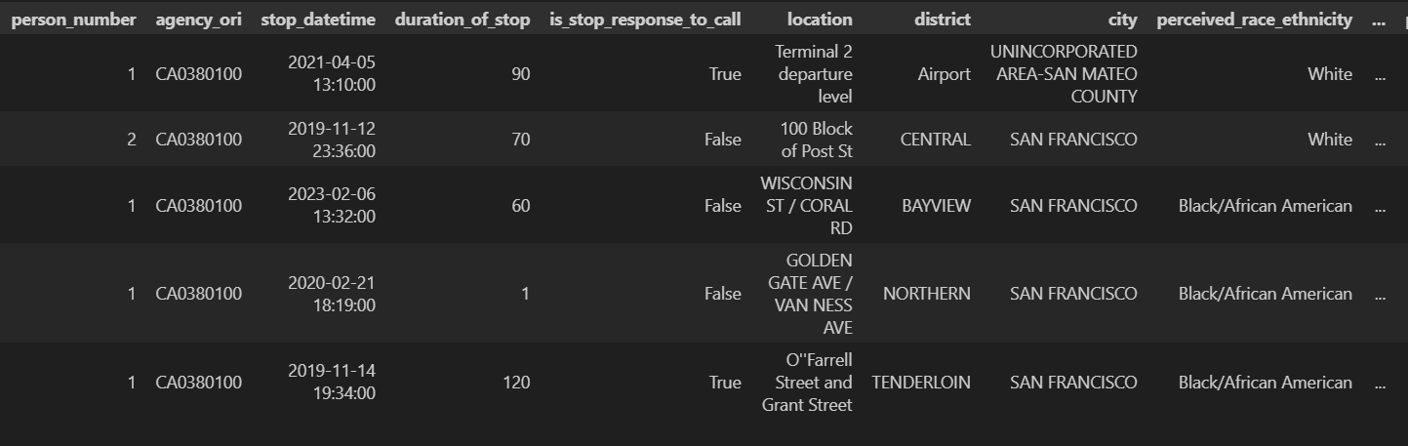
Dataset & objectives
250 000 enregistrements - 46 colonnes
Analyze racial disparities in police stops and identify any biases or discriminatory patterns.
Create predictive models to estimate the duration and outcome of a police stop based on various factors.

Slide 3
Exploratory Data Analysis

Slide 4
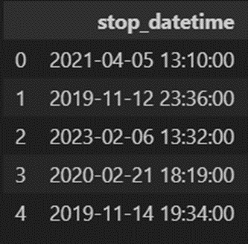
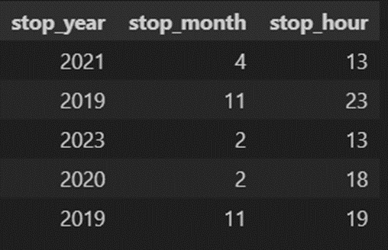
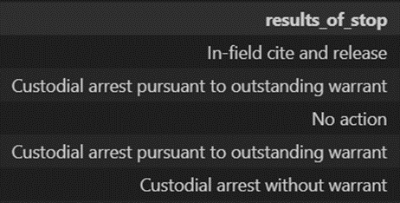
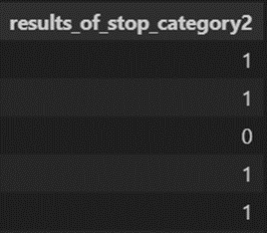
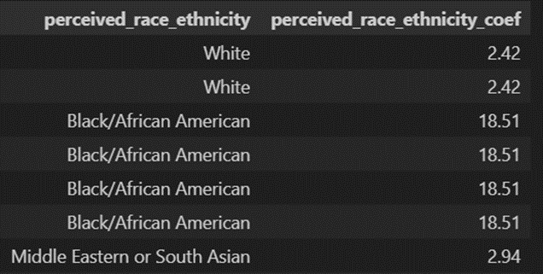
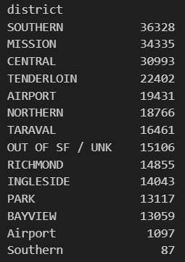
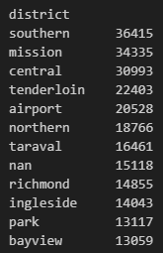
Transforming the data
Hour & date extraction (month, year…) into new features
Regrouping “results_of_stop” into 2 categories
→ 0 : No action - 1 : Action
Creation of an ethnicity coefficient to show importance of the race disparity in San Francisco population
Letter case homogenization for “District” variable

Slide 5
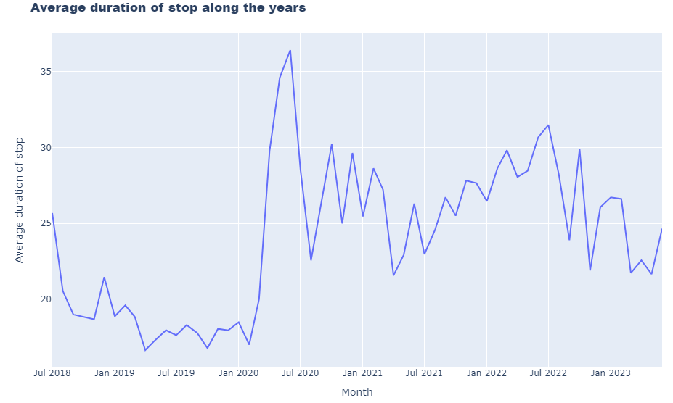
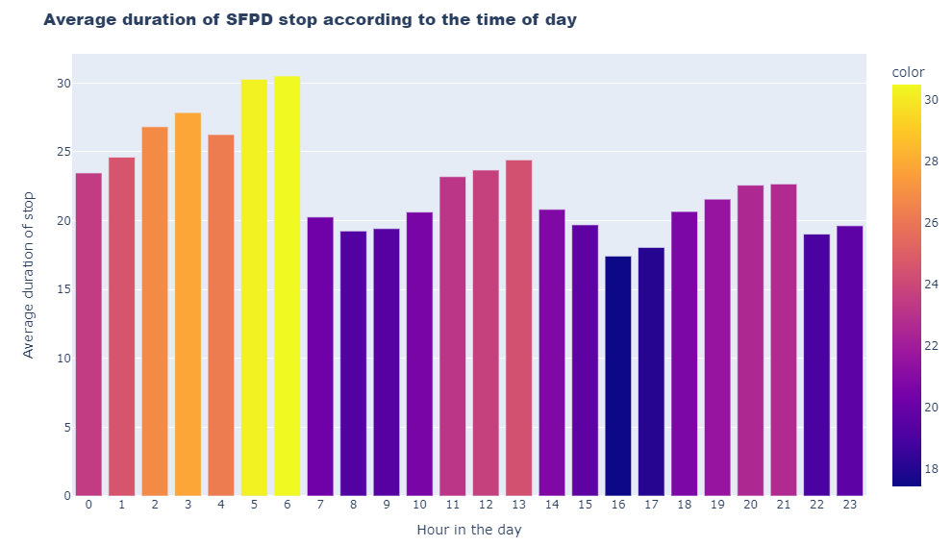
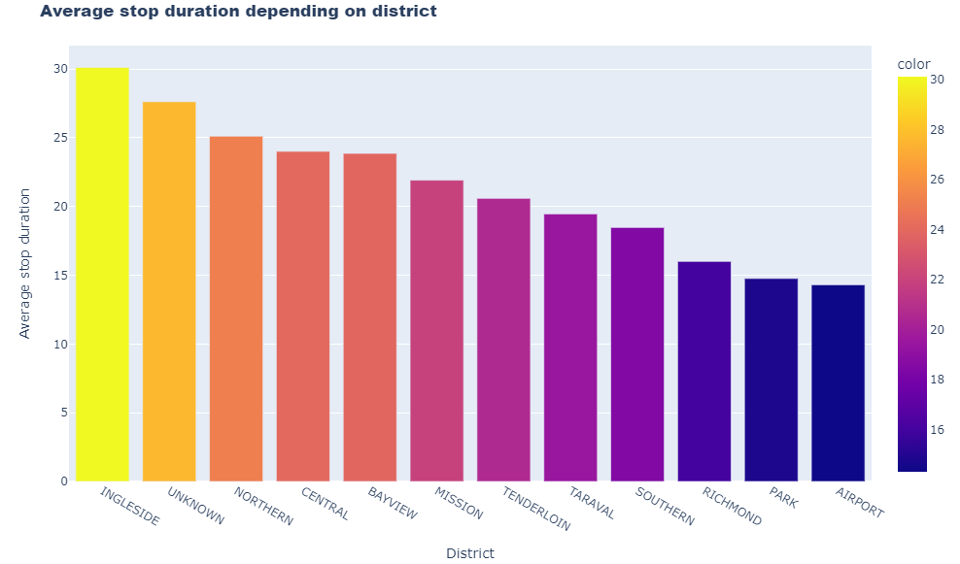
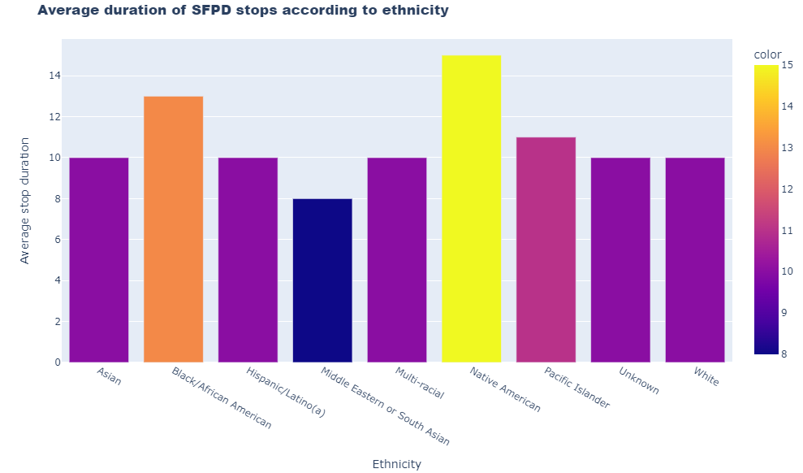
Average duration of stops

Slide 6
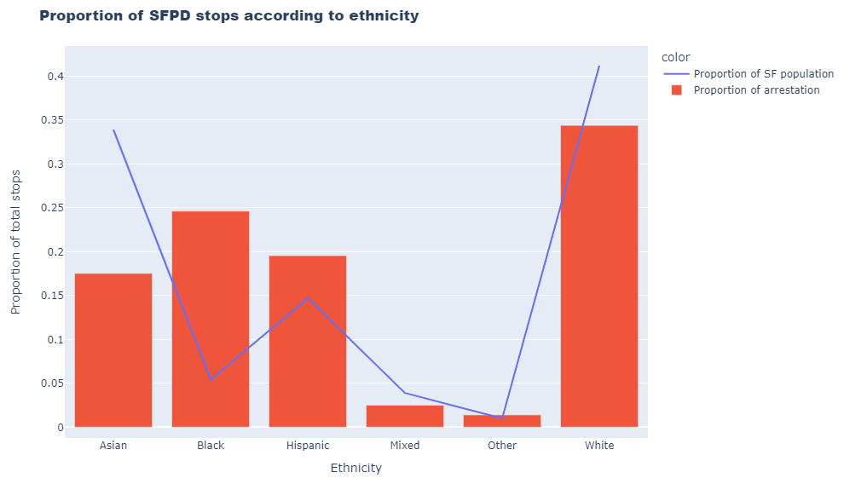
Race proportion in stops vs SF population

Slide 7
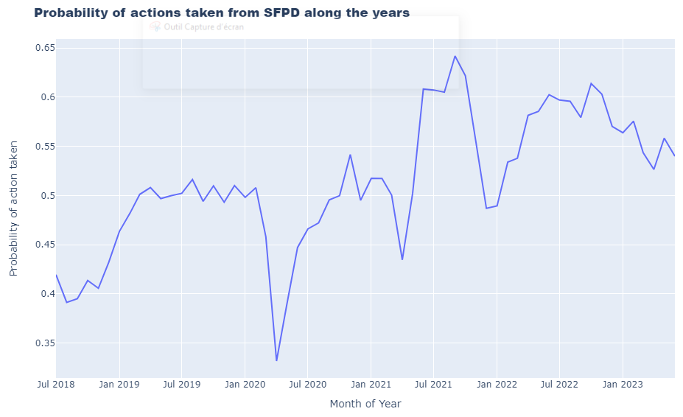
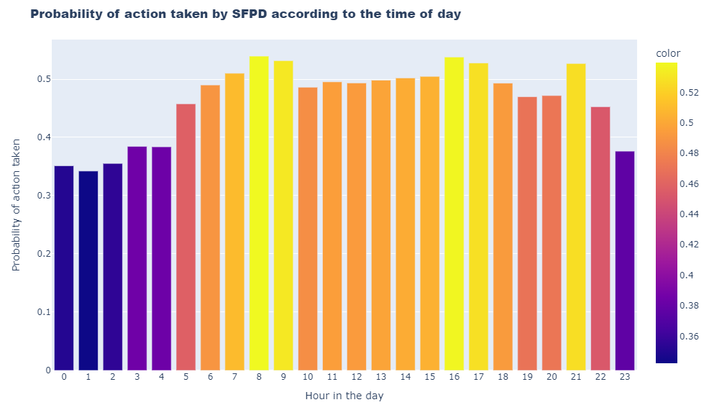
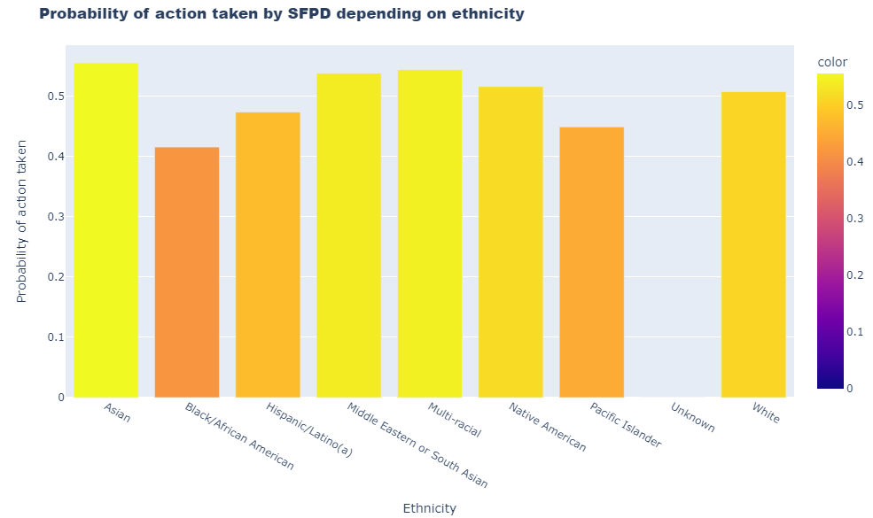
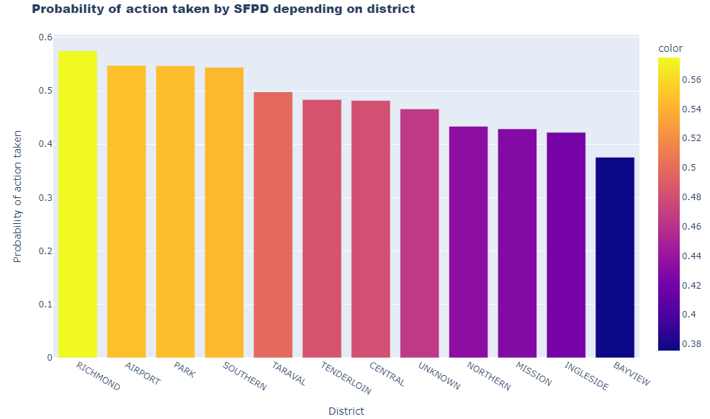
Probability of Actions taken vs various features

Slide 8
Target 1 : Duration of stop

Slide 9

Pre-processing
Features listing =>
Missing values checking
Split test running =>
Missing values replacing
Normalization =>

Slide 10

Model Study
Model training => Using Linear Regression model
Scoring =>
Conclusion =>
This model poor results led us to reconsider our initial target and switch our approach to a classification one.

Slide 11
Target 2 : Results of stop (divided into 2 categories)

Slide 12

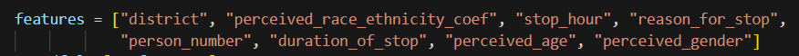
Decision Tree Classifier - Pre-processing
Features listing
Missing values checking
Split test running =>
Missing values replacing
Normalization =>
→ 0 : No action - 1 : Action

Slide 13
Model Study
Model training => Using DecisionTreeClassifier model
Fitting Improvement
=> Various Features List
=> Various models testing :
Logistic Regression
Random Forest Classifier
=> Hyper parameters tweeking (max_depth, n_estimators)
Conclusion =>
Overfitting contained and F1_score > 0.80
Satisfying results according to the original data.

Slide 14
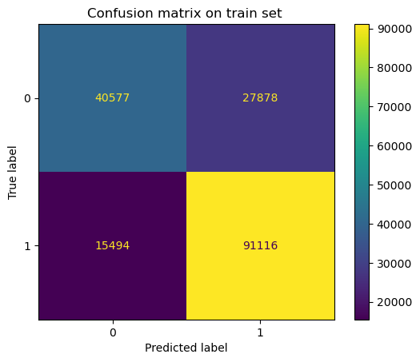

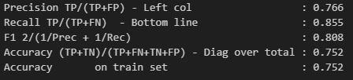

Evaluation of DecisionTreeClassifier model

Slide 15
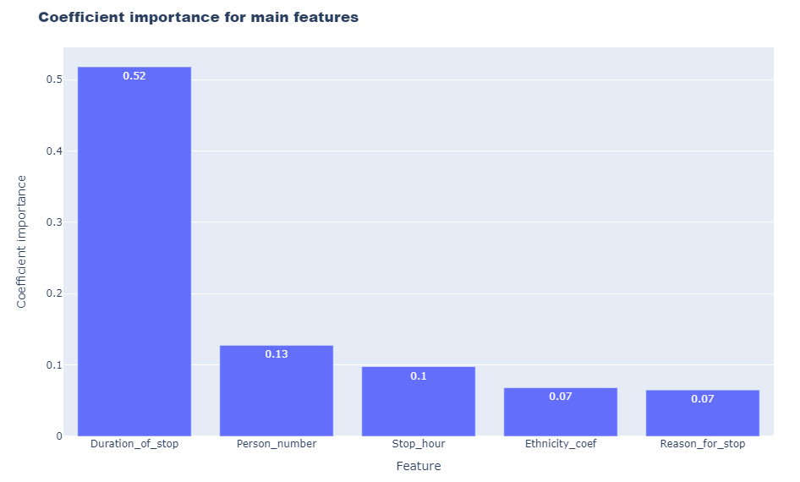
Top 5 features importance

Slide 16
Other angles of potential investigations
Exploring the dataset using the datetime features differently :
Day time Vs. Night time
Before Covid period Vs. After Covid period
Seasonality Analysis
Exploring the dataset through different targets :
Police actions taken Vs. Race and ethnicities
Duration of stop Vs. Hours of the day
Number of stop Vs. Covid / Non Covid periods

Slide 17

Thanks guys!

Slide 18
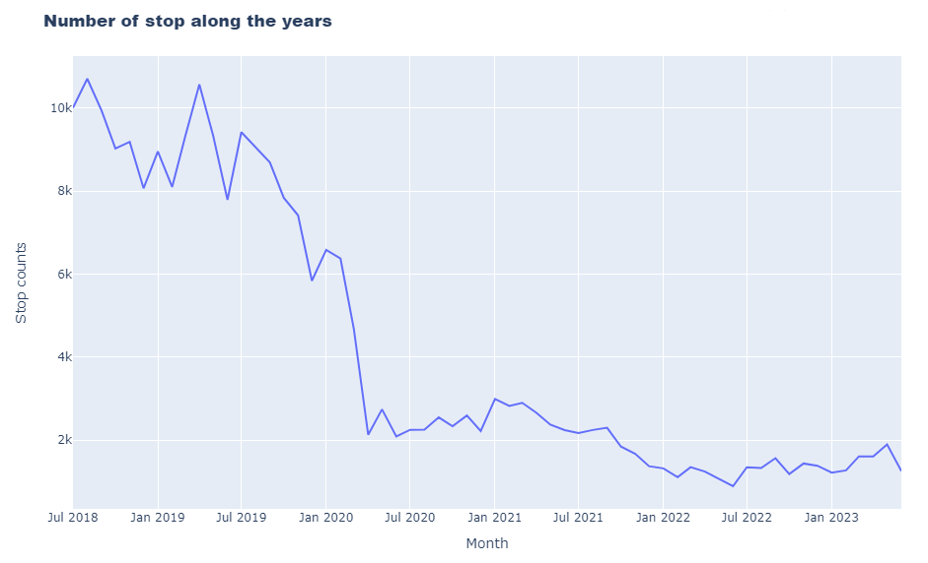
Number of stops along the years (2018-2023)
Significant impact of Covid-19 on SFPD stops

Slide 19
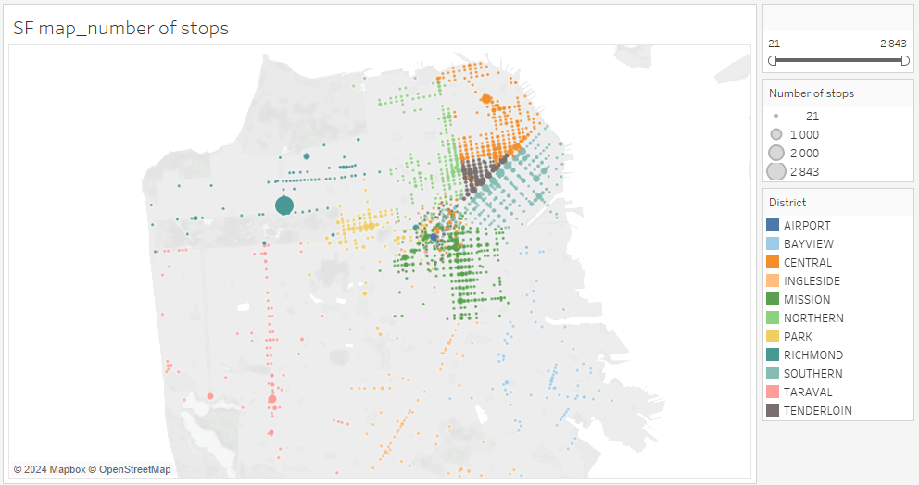
Number of stops by districts

Slide 20
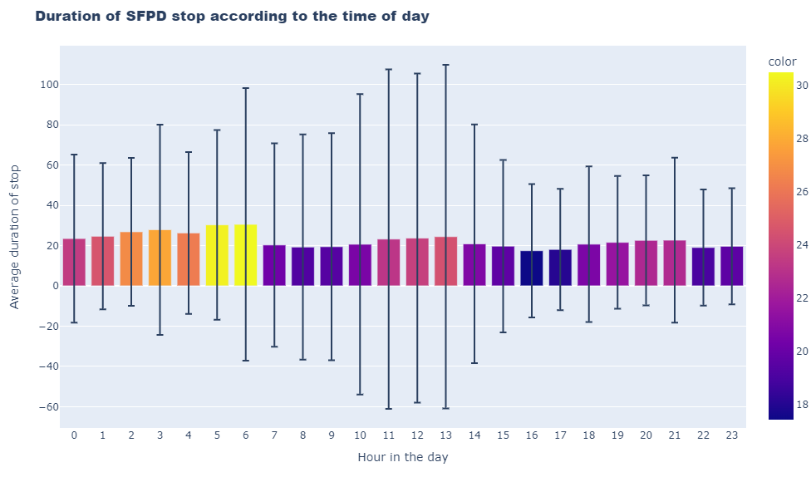
Warning ! Huge standard deviation…

Slide 21
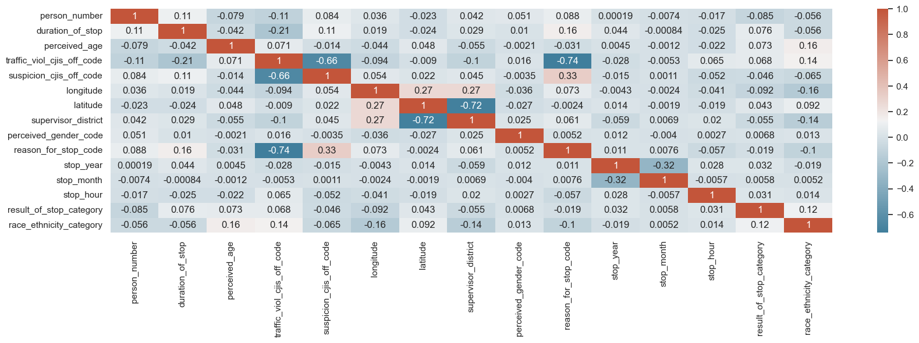
Correlation heatmap

Slide 22
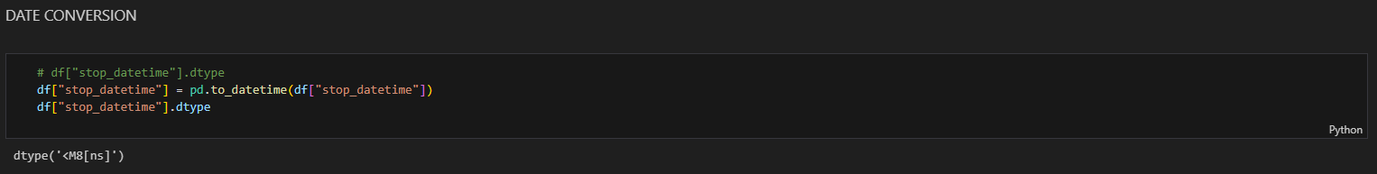
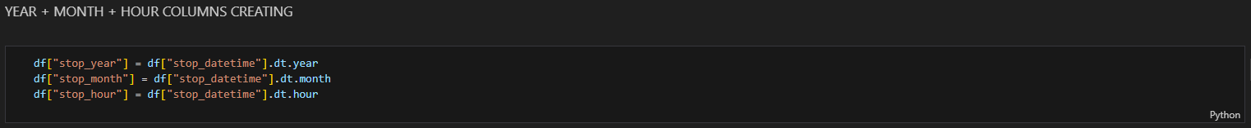
Feature : stop_datetime

Slide 23
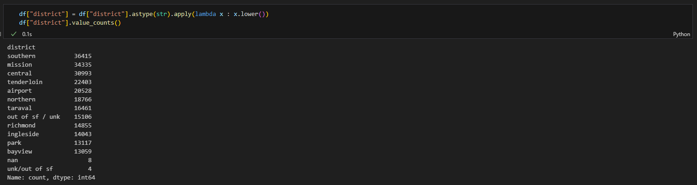
Feature : district

Slide 24
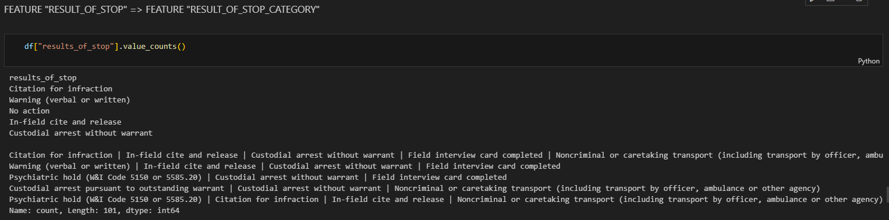
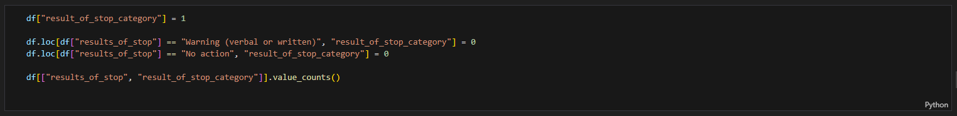
Feature : result_of_stop_category

Slide 25
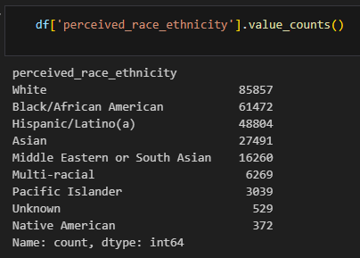
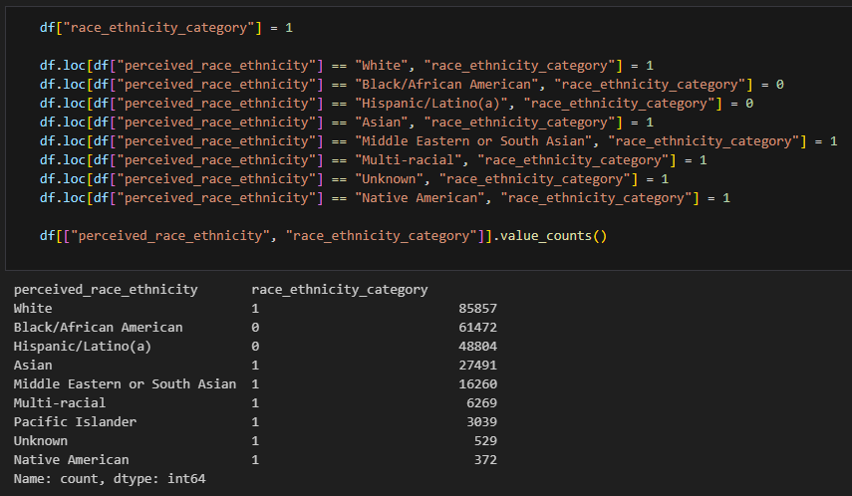
Feature : race_ethnicity_category

